Slide 1
The Ecosystem Management Decision Support System
Latest features of version 7.0
Keith Reynolds, USDA Forest Service
Steve Paplanus, Mountain View Business Group, LP
Marek Druzdzel, BayesFusion LLC
Clive Spenser, Logic Programming Assoc., LTD
Philip Murphy, InfoHarvest, Inc.
Bruce Miller, Rules of Thumb, Inc.

Slide 2
EMDS 7.0 – the basics
First production release in February 1997
Version 7.0 just about to be released
A general application framework for designing and implementing knowledge-based decision support applications for environmental analysis and planning at any geographic scale or scales.
Integrates GIS as well as knowledge-based reasoning and decision modeling technologies to provide decision support for a substantial portion of the adaptive management process of ecosystem management.

Slide 3
Applications to date
Some major examples
Ecological site classification, UK Forestry Commission
Timber suitability, Tongass NF
Aquatic/Riparian Effectiveness Monitoring Program , USFS Region 6
Spotted owl dispersal habitat, WA DNR
North Coast Watershed Assessment, State of CA
Soil impacts associated with logging and wildfire, Okanogan-Wenatchee NF
Integrated resource restoration and protection, USFS Region 1
Roads analysis for wildlife habitat, Tahoe NF
Wildland fuels, USFS WO and Regions, BLM, BIA, FWS, NPS
Managing critical loads associated with atmospheric S + N deposition in the southern Appalachians, US EPA
Integrated landscape restoration, Okanogan-Wenatchee NF
National terrestrial condition assessment, USFS national and Regions
Many other applications from around the world
http://en.wikipedia.org/wiki/EMDS

Slide 4
EMDS platforms at version 7
ArcMap
QGIS
MapWindow
DotSpatial
On the horizon
A web-based enterprise edition (Azure Government Cloud)

Slide 5
Databases supported
Currently
SQLITE
SQL Server
Oracle
On the horizon
Azure SQL Server
Postgres

Slide 6
Engines for core analytical tasks
NetWeaver – logic processing
Supports design of very large, complex, abstract models
CDP – multicriteria decision analysis
Supports strategic and tactical planning
VisiRule – prolog-based decision trees
GeNIe – Bayesian networks
Workflows allow invoking any sequence of these engines

Slide 7
Architecture of an EMDS project
Multiple assessments
Defined by the set of layers and spatial extent
Multiple analyses within an assessment
Multiple scenarios within analyses (NW)
Analyses and scenarios can be compared with a change detection utility

Slide 8
Scripting tools
R
Java
Python
C#
Tasks for these can be inserted anywhere in a sequence of analytical tasks (Windows Workflow)
Data analysis and summarization
Data transformation between analytical tasks

Slide 9
Workflows
EMDS is built on the open source Windows Workflow Foundation
Supports task sequencing via Flowcharts, Sequential diagrams, and State Machines
Leveraging Trident
An open source workflow solution and editor from NOAA built on Windows Workflow
EMDS uses several UI and provenance structures from Trident
Workflow engines and editors
Activities programmed in VB or C#.
Call external scripts written in R, Python, or Javascript
KNIME and WexFlow
Data processing and statistics with R

Slide 10
On the horizon
Support for map publishing services
ArcGIS online
MapServer (open source)
Web-based enterprise edition
Semantic editor
For ontologies

Slide 11
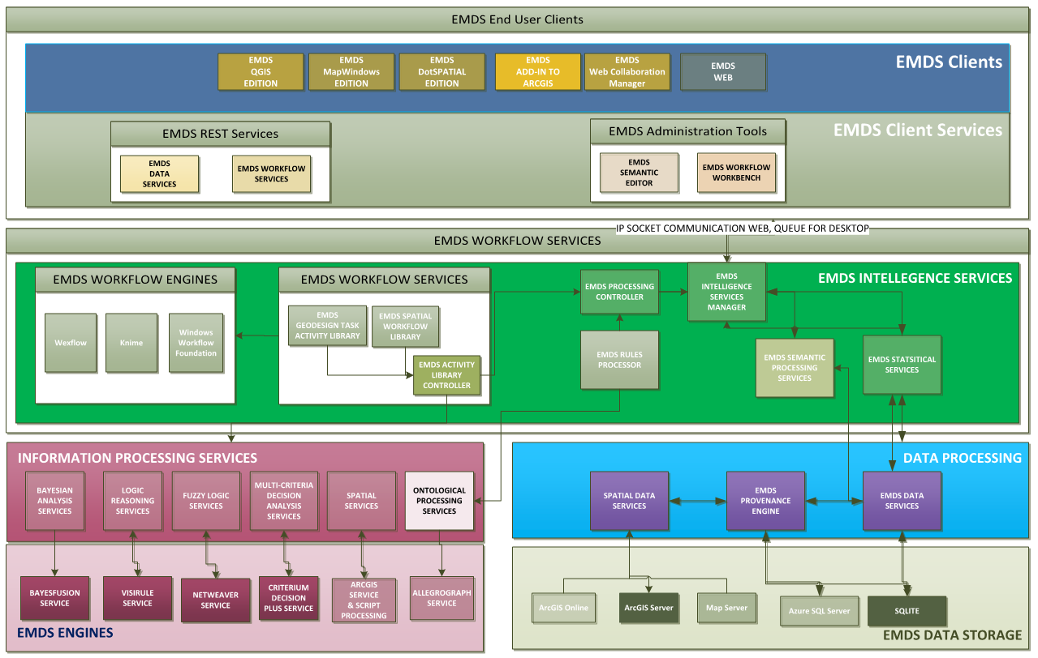
System architecture
A state-of-the-art, industrial strength, enterprise solution
for environmental analysis and planning

